Slide 1
Quality Management System
System Awareness Training

Slide 2
What is a Quality Management System
  A set of documentation consisting of policies, procedures, documents, forms and records
  Describes the process flows of an organisation and the interaction between functional units
  Ours is based on the standard ISO 9001

Slide 3
Why?
Market demands
Company objectives
  As outlined in our quality policy;
    Satisfied clients
    Continual improvement
    Interested parties
    Risk profile

Slide 4
The Structure
Based on ISO 9001
  Policy
  Manual
  Procedures
  Documents
  Registers
Found on myQuality™ myquality;
https://www.myquality.com.au/myquality/
Notes:
Remind them to keep the folder up to date. If they loose it, damage it, what ever, they should contact Pat and get them updated

Slide 5
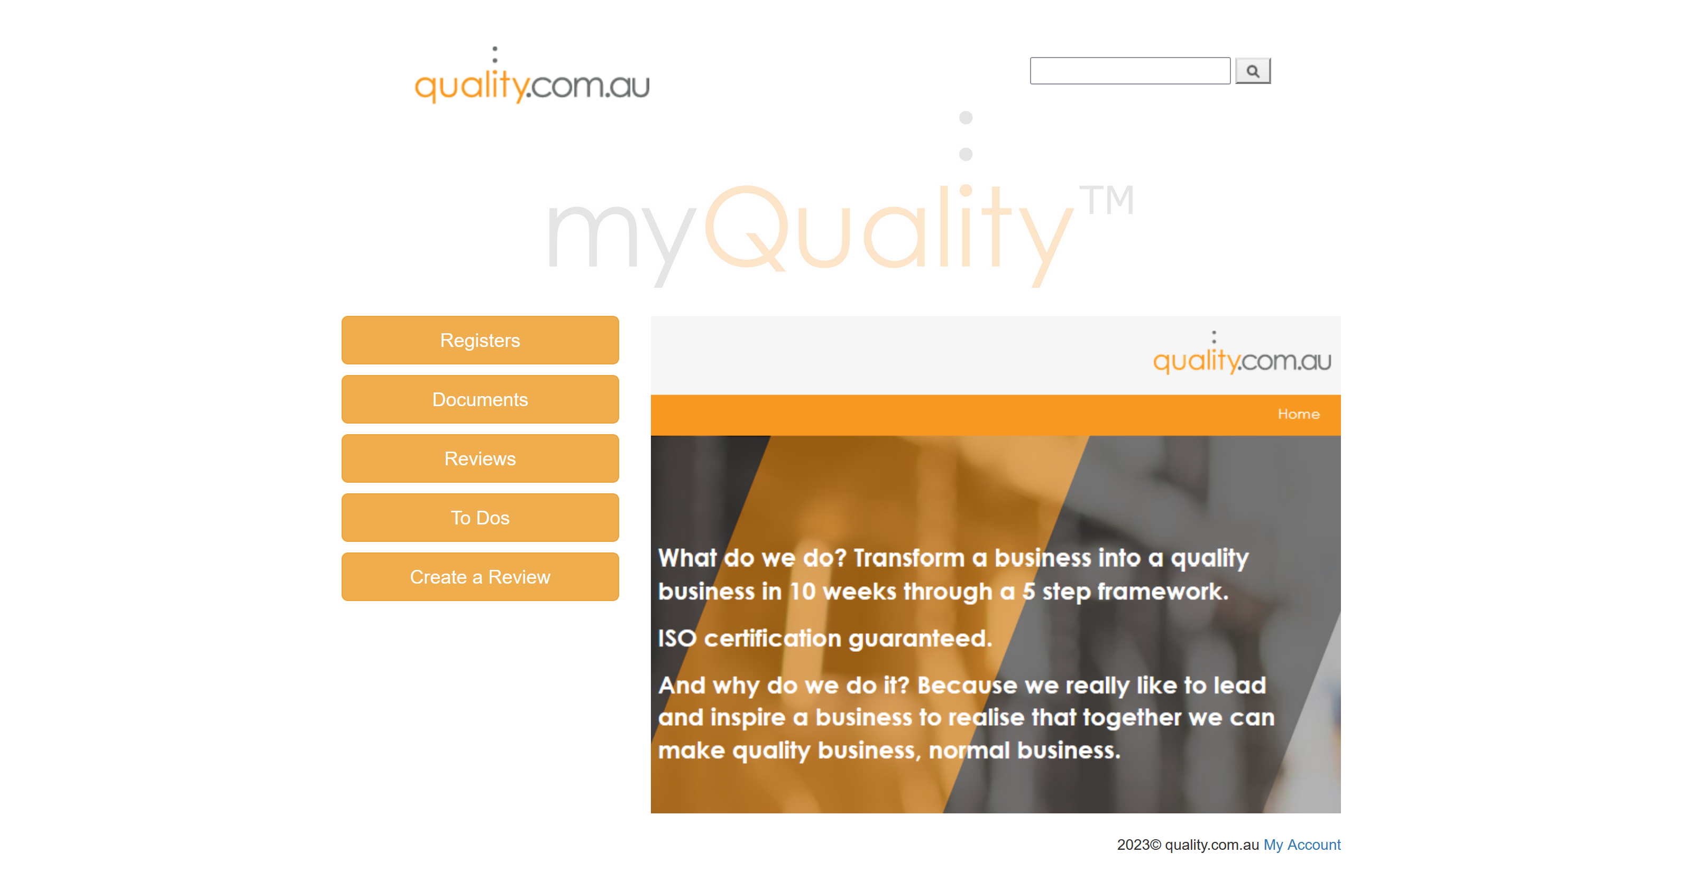
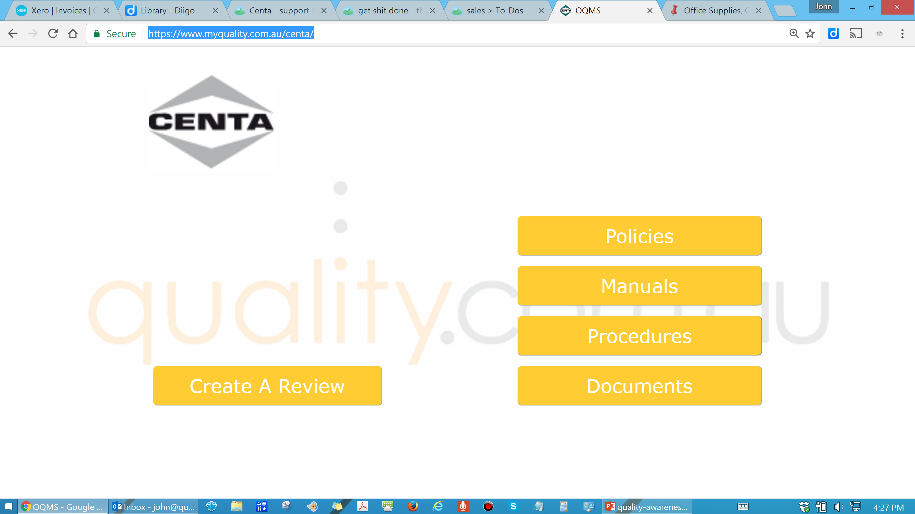
The Structure
Notes:
Remind them to keep the folder up to date. If they loose it, damage it, what ever, they should contact Pat and get them updated

Slide 6
Corporate
John Mason is the Top Management representative
Ron Feruglio is our quality coordinator
quality.com.au looks after; internal audits, management reviews, document management, corrective actions and more.
Notes:
Policies - Get them to read them at least once
QE Work Plan – Get them to read this once. Go through the plan with them, highlighting the structure, their responsibilities, the prevention of pollution and the emergency stuff
Remind them about the checklists and the need to do them. Tell them that you and Kevin will be conducting cross checks in the field.
General discussion on the MSDS’s
Take down the procedures off the wall. They will be reviewed and re-issued after the audit.

Slide 7
Certification
Global-Mark is our certification service provider
This means they are independent auditors of our system – not our people
The process is……
  Read, observe, interview, check records.
  Sample and evidence
The audit is scheduled for the 13th Nov 2023
Audit anniversary is each year, 12 after the audit date
Notes:
The audit will be 14, 15, 16 February
The auditor will be going on site to watch at least one job – set up who
Housekeeping in the workshop, storage room, wash up room (keep this door closed at all times) need to be done
Be aware you are part of the system

Slide 8
How to Contribute
  Read the quality policy
  Be aware of your impact on the system
    Each of you are part of it
  Be positive
    If something is wrong or a process can be improved, tell John Mason and/or raise a review.
  Be system savvy
    Learn how to find the information
  Enjoy the journey

